Slide 1
Major Project On
“Analysis of Different Electrical Components and Properties of a RLC circuit using Machine Learning ”
Under the guidance of: By:
Mr. Jatin Ayush Gangwar 16/IEC/009
Shashank Singh 16/IEC/057
Rishabh Rathi 16/IEC/033

Slide 2
CONTENTS
Motivation
Introduction
Project Overview
Process
Algorithms Used
Formulae Used
Datasets Used
Outputs
Results
Applications
Advantages
Disadvantages
Future Scope
Conclusion
References

Slide 3
MOTIVATION
Circuit designing is essential but complicated. A lot of calculation goes in finding the desired value of different electrical components required in the circuit which can be very time consuming.
Machine Learning is a hot topic nowadays through which computers can learn and predict output from experience without external programming.
Using ML algorithms one can easily find the desired value of different components based on different properties for optimum efficiency of circuits.

Slide 4
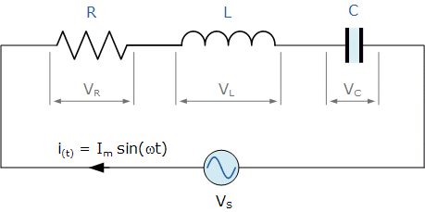
INTRODUCTION
What is an RLC circuit?
The circuit which consists of resistor-capacitor and inductor is an RLC circuit it may be connected in series or in parallel. Thus it forms a harmonic oscillator for current and it will resonate in a similar way as an LC circuit. it could be also called as a second-order circuit as any voltage or current can be described by a second-order differential equation for the analysis of the circuit.

Slide 5
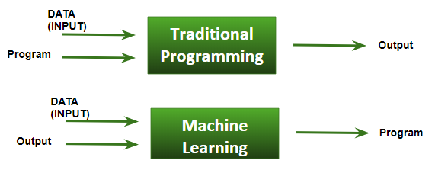
INTRODUCTION (cont)
WHAT IS MACHINE LEARNING ?
Machine learning is an application of artificial intelligence (AI) that provides systems the ability to automatically learn and improve from experience without being explicitly programmed. Machine learning focuses on the development of computer programs that can access data and use it to learn for themselves.

Slide 6
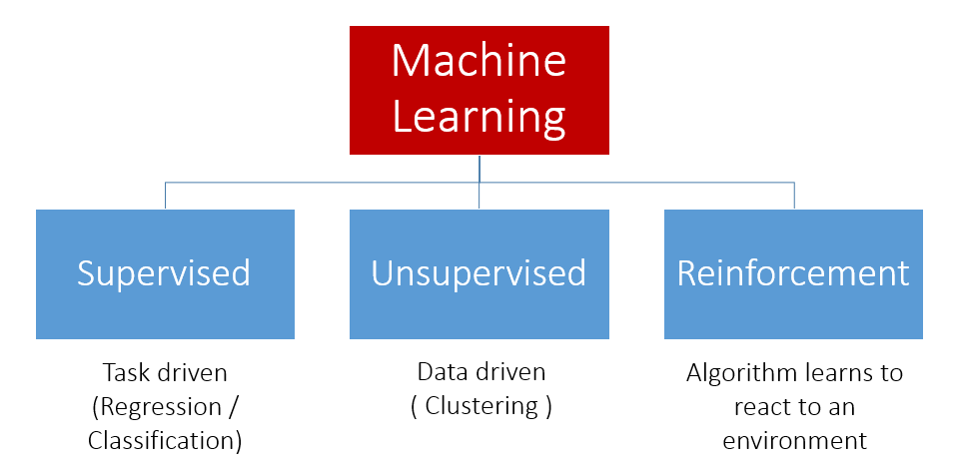
INTRODUCTION (cont)
The Types of Machine Learning Algorithms

Slide 7
PROJECT OVERVIEW
We used 7 different datasets (Resistance, Capacitance, Inductance, Quality Factor, Damping Factor, Resonance Frequency and Bandwidth) for this project.
Created ML models using Simple Linear Regression and Ridge Regression .
Codes for the models were written using Python language on Spyder (Anaconda3) IDE.
The models were tested and trained using the above mentioned datasets for predicting values of components.

Slide 8
PROCESS
Datasets are procured.
Datasets are divided into testing and training datasets.
ML models are created using ML algorithms and trained using training data.
ML models are tested using testing data through which accuracy of model is calculated.
When accuracy of model is greater than threshold then model is ready for predicting output.
Required output is calculated.
flow chart.docx

Slide 9
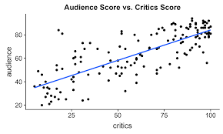
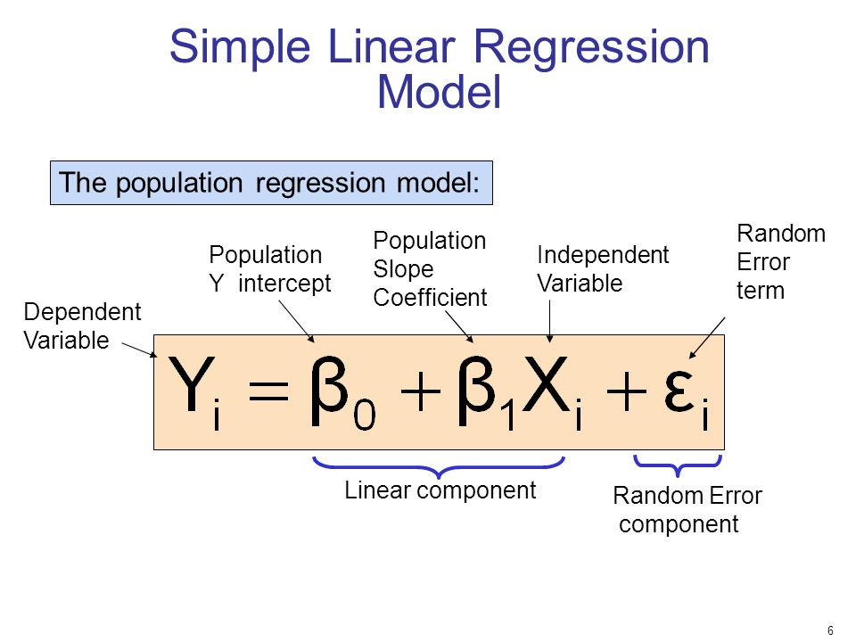
AlGORITHMS USED
Simple linear regression- it concerns two-dimensional sample points with one independent variable and one dependent variable and finds a linear function.

Slide 10
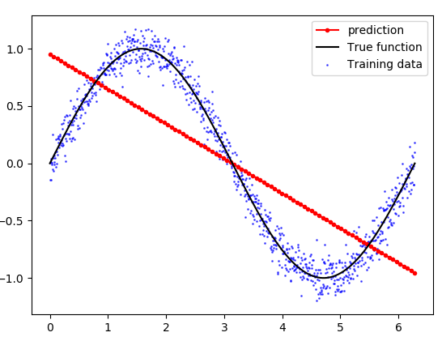
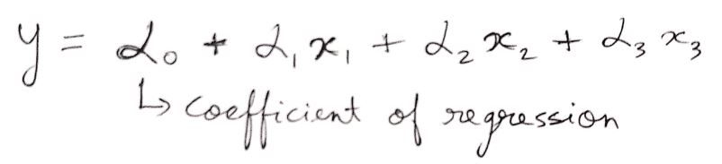
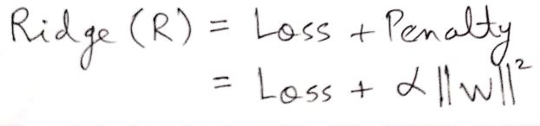
ALGORITHMS (cont)
2. Ridge Regression- Ridge regression is a way to create a parsimonious model when the number of predictor variables in a set exceeds the number of observations, or when a data set has multicollinearity (correlations between predictor variables).

Slide 11
FORMULAE USED
The formulae used in creating the datasets of quality factor, damping factor, resonance frequency & bandwidth are as follows:
For a series RLC circuit:
Quality Factor(Q) = (1/R)*√(L/C)
Damping Factor( ζ ) = (R/2)*√(C/L)
Resonance Frequency(ƒ_{r} ) = 1/(2π* √(LC))
Bandwidth(BW) = R/(2 π L)
where R→Resistance, L → Inductance, C →Capacitance
π =3.14

Slide 12
FORMULAE (cont)
The following formula was used for creating Inductance dataset:
Here L → Inductance
l → Wire Length
w → Wire Width
t → Wire Thickness

Slide 13
DATASETS USED
Resistance Dataset
Parameters:
Wire Length
Wire Width
Temperature
Resistance
Training set→ 8000 values
Testing set→ 2000 values

Slide 14
DATASETS (cont)
2. Capacitance Dataset
Parameters:
Wire Length
Wire Width
Wire Thickness
Capacitance
Training set→ 10000 values
Testing set→ 2000 values

Slide 15
DATASETS (cont)
3. Inductance Dataset
Parameters:
Wire Length
Wire Width
Wire Thickness
Inductance
Training set→ 10000 values
Testing set→ 2000 values

Slide 16
DATASETS (cont)
4. Quality Factor Dataset
Parameters:
Resistance
Capacitance
Inductance
Quality Factor
Training set→ 10000 values
Testing set→ 2000 values

Slide 17
DATASETS (cont)
5. Damping Factor Dataset
Parameters:
Resistance
Capacitance
Inductance
Damping Factor
Training set→ 10000 values
Testing set→ 2000 values

Slide 18
DATASETS (cont)
6. Resonance Frequency Dataset
Parameters:
Capacitance
Inductance
Resonance Frequency
Training set→ 10000 values
Testing set→ 2000 values

Slide 19
DATASETS (cont)
7. Bandwidth Dataset
Parameters:
Resistance
Inductance
Bandwidth
Training set→ 8000 values
Testing set→ 2000 values

Slide 20
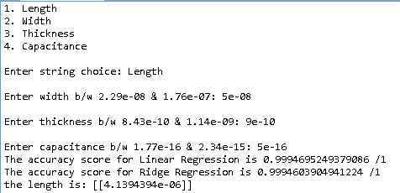
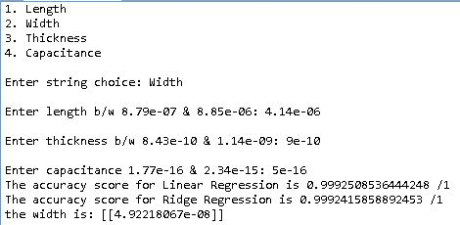
OUTPUT
Capacitance

Slide 21
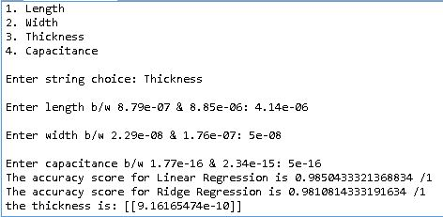
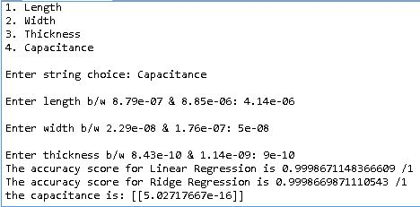
OUTPUT (cont)
Capacitance

Slide 22
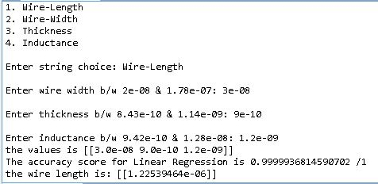
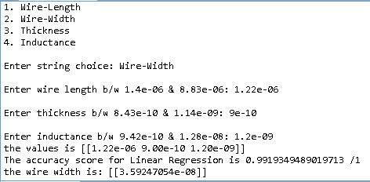
OUTPUT (cont)
Inductance

Slide 23
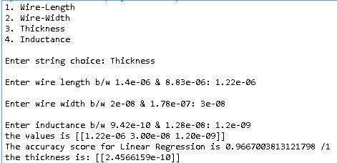
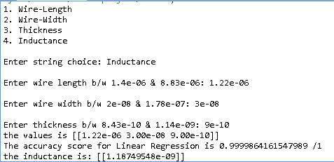
OUTPUT (cont)
Inductance

Slide 24
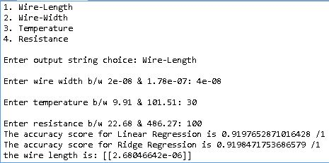
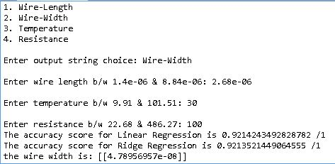
OUTPUT (cont)
Resistance

Slide 25
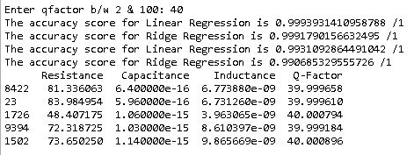
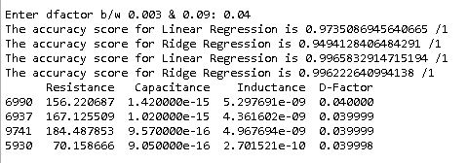
OUTPUT (cont)
Quality Factor
Damping Factor

Slide 26
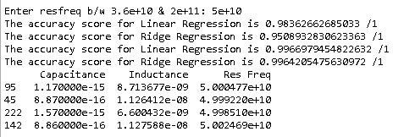
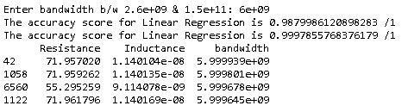
OUTPUT (cont)
Resonance
Frequency
Bandwidth

Slide 27
RESULT
Following results are obtained in this project:
In the Resistance code, the ML model can predict desired value with 92-95% accuracy.
In the Capacitance code, the ML model can predict desired value with up to 99% accuracy.
In the Inductance code, the ML model can predict desired value with up to 99% accuracy.
In the Quality factor code, the ML model can predict desired value with up to 99% accuracy.
In the Damping factor code, the ML model can predict desired value with up to 99% accuracy.
In the Resonance frequency code, the ML model can predict desired value with up to 99% accuracy.
7. In the Bandwidth code, the ML model can predict desired value with up to 99% accuracy.

Slide 28
APPLICATION
Complex Circuit Designing.
Electrical Components Designing.
RLC circuits are use for the tuning process of an oscillator circuit, radio receiver and television sets.
Series RLC circuit does the signal processing of communication system.
Resonant series LC circuit does voltage magnification.
RLC circuit is used for filtering purpose as it does not allow unwanted oscillations that would otherwise cause signal distortion, noise and damage to circuit to pass through it.

Slide 29





ADVANTAGES

Slide 30


DISADVANTAGES

Slide 31
Future Scope
This project can be very helpful in designing much more complex circuits with many more circuit elements if good quality and large datasets can be procured and feeded to the Machine Learning Algorithms.
This project can also be used to design suitable circuit elements with respect to many different material properties and atmospheric conditions if a relationship can be established between them or good quality and large datasets can be obtained based on different variables.
These circuit elements can then be used to design desirable circuits depending on customer needs with optimum efficiency.

Slide 32
CONCLUSION
Design different electrical components such as Resistance, Capacitance and Inductance based on different material properties such as Wire Length, Width, Thickness(for capacitance & inductance) and Temperature(for resistance) using machine learning algorithms.
Design different RLC circuits based on different properties such as Quality factor, Damping factor, Resonance frequency and Bandwidth using machine learning.
This project can be very useful to electrical circuit designing companies as it can learn from a large dataset and predict values for different components over a million possible values feeded by the user using machine learning.

Slide 33
REFERENCES
[1]For Resistance dataset: https://www.kaggle.com/c/vlsi-wire-resistance- estimation/data
[2]For Capacitance dataset:
https://github.com/srohit0/mida/blob/master/notebooks/Capacitance%20%20Estimation.ipynb
[3]For Inductance dataset: https://chemandy.com/calculators/flat-wire-inductor-calculator.htm
[4]Gulden Kaya Uyanik, Nese Guler: A study on multiple linear regression analysis. https://sciencedirect.com
[5]Khushbu Kumari, Suniti Yadav: Linear Regression Analysis Study
[6]Donald W. Marquardt, Ronald D. Snee: Ridge Regression in Practice

Slide 34


